Slide 1
Loan Management system
By team-6 (Navaneethakrishnan )
Mentor : Javeed sir

Slide 2
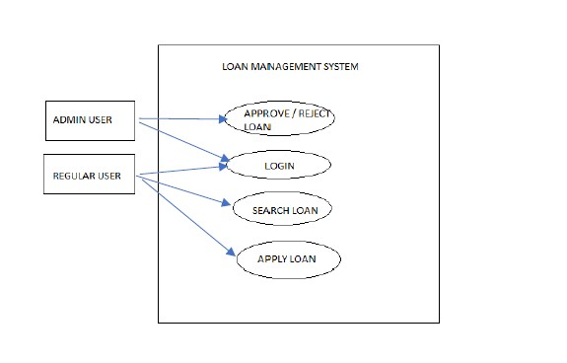
Use case diagram (Case study Functions)

Slide 3
Technologies used
Frontend: Angular Js.
Backend: Java, Spring Boot.
Database: MySql.
Authentication: JSON Web Tokens (JWT) for secure user authentication.

Slide 4
Admin functionality :
Log In
Mange loans
Loan Approval
Loan rejection
Document Verification
Logout

Slide 5
Loan customer functionality :
Sign Up as User
Log In as User
Apply loan
Check loan status
Loan History
Upload document
Logout

Slide 6
What system will do?
Authenticate User
Store Loan Apply Detail
Store Document for verification
Store Property details, customer details and Account details

Slide 7
Flow of application
Firstly, opening the application will redirect you to the home page.
In home page you will get an option to visit the about.
Also you will get an option to sign up and sign in as user and admin.
After signing in as an Admin, you will have rights to Approve, Reject Loan, Document download and Logout.
After Signing Up and Signing In as User you can Apply Loan, check loan Status, loan history and Logout.

Slide 8
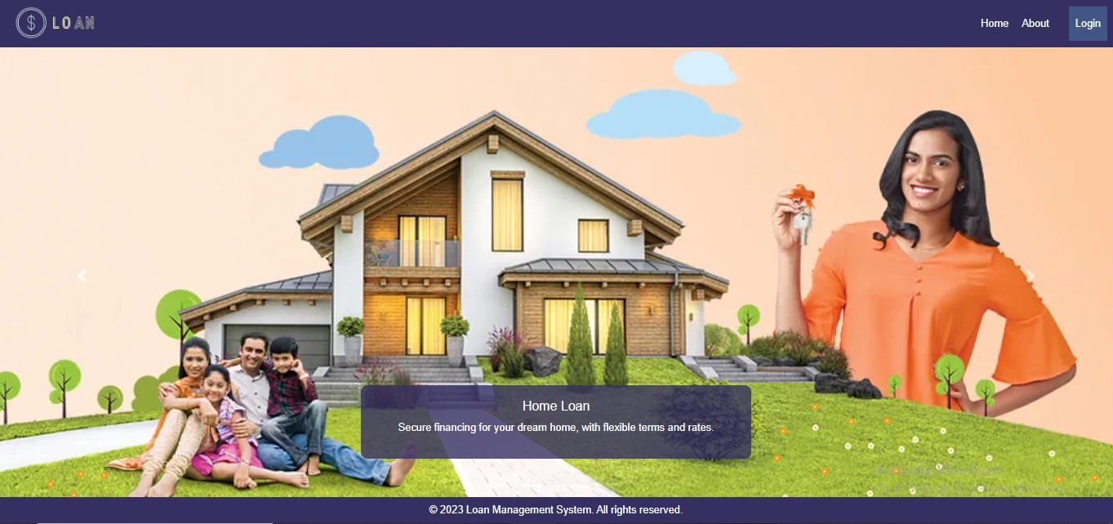

Slide 9
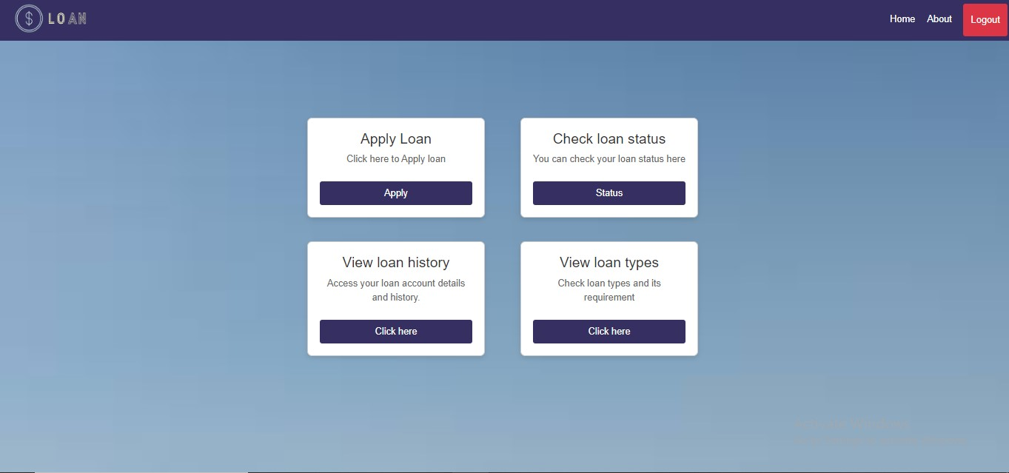

Slide 10
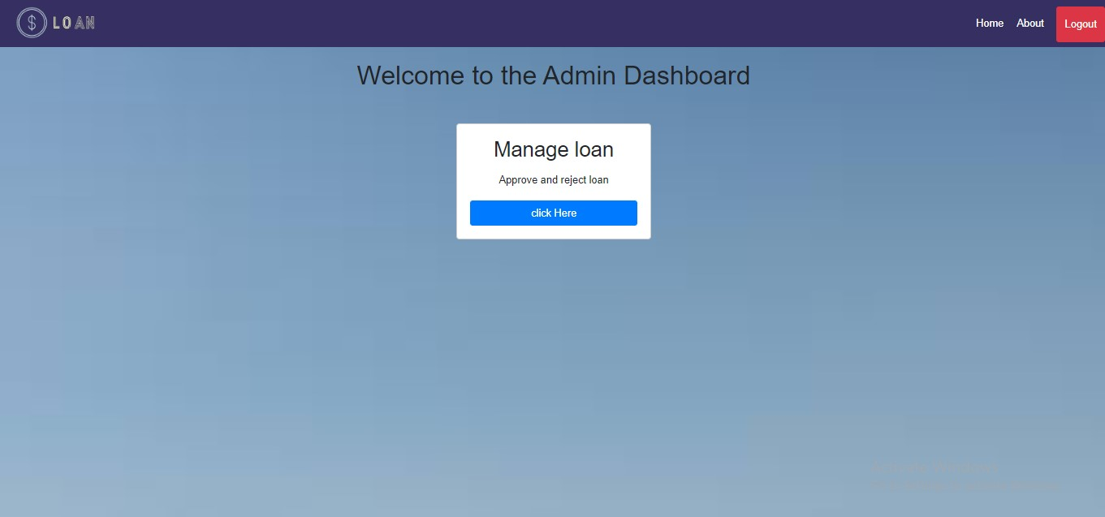

Slide 11
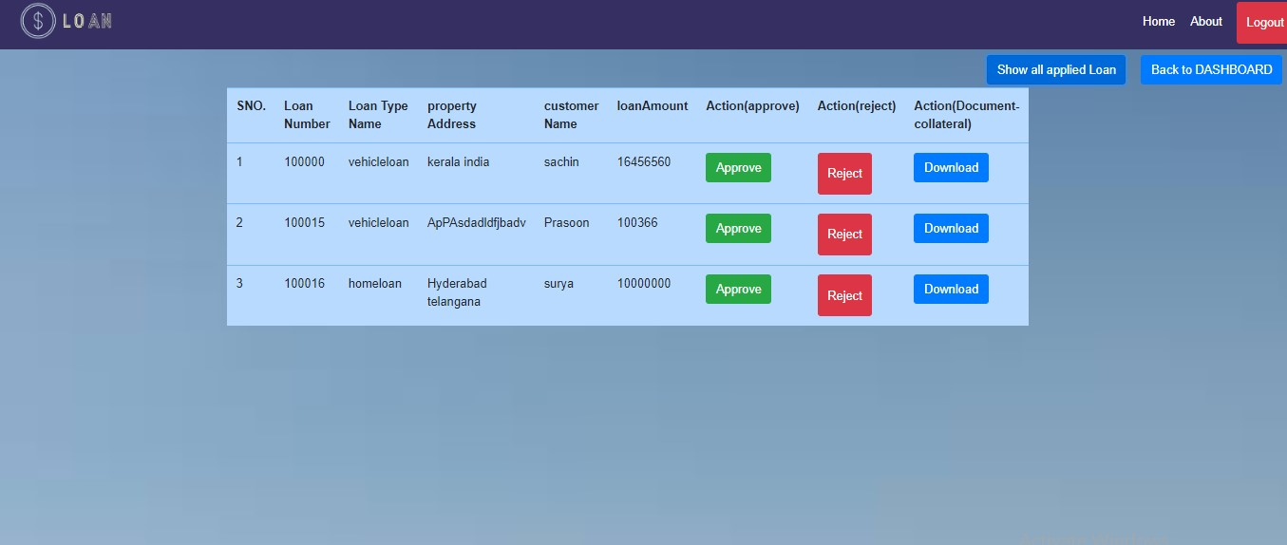

Slide 12
THANK YOU

